Slide 1
Analysis Tibias and Hips
15.08.2024

Slide 2
Preprocessing
Read samples and add metadata
Clean rows that have rowSums < than 30 counts

Slide 3
Plot PCA
Tibias
Hips
Pellets/SVFs
Adipocytes

Slide 4
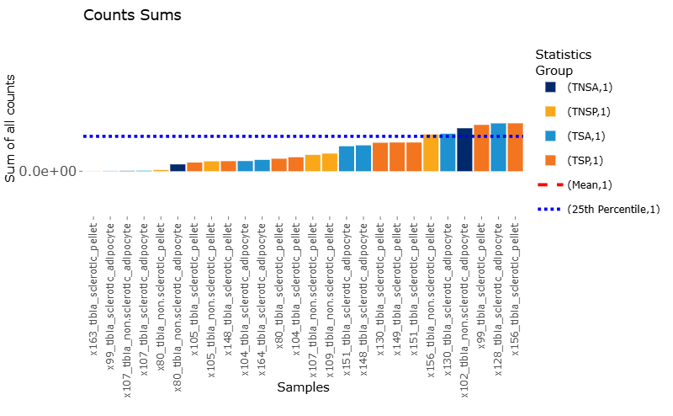
Filtered samples Tibias
Plus extra 80 and 107 as 3 were removed to avoid noise

Slide 5
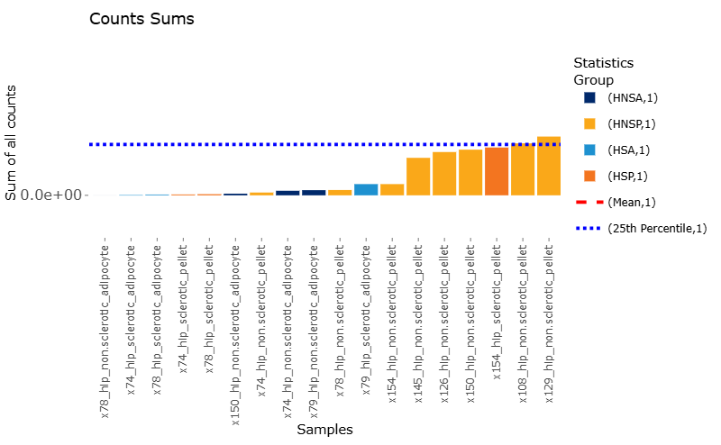
Filtered samples Hips

Slide 6
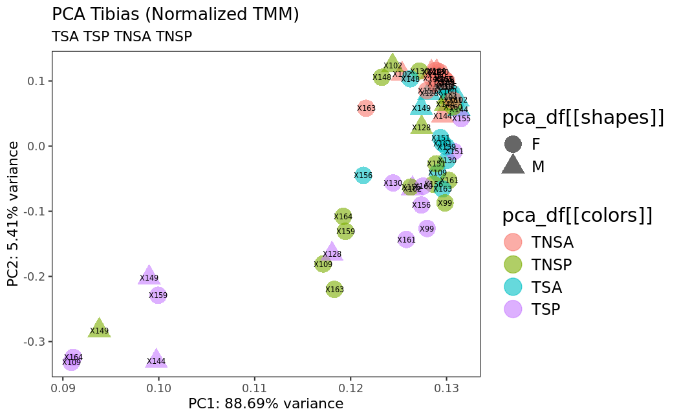
Normalized samples TIBIAS after removing samples due to low number of reads

Slide 7
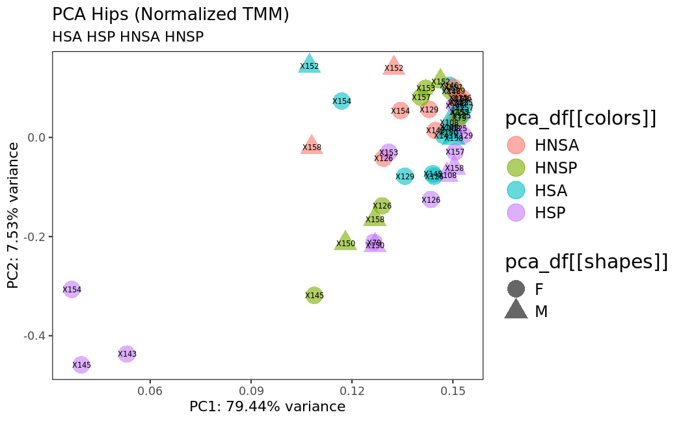
Normalized samples HIPS after removing samples due to low number of reads

Slide 8
Extra normalized plots
Find normalized PCAs for:
Tibias adipocytes
Tibias pellet
Find normaliued PCAs for:
Hips adipocytes
Hips pellet
Sclerotic and non-sclerotic
Tibias and hips together
Non sclerotic
Pellet
Adipocytes
Sclerotic
Pellet
Adipocytes

Slide 9
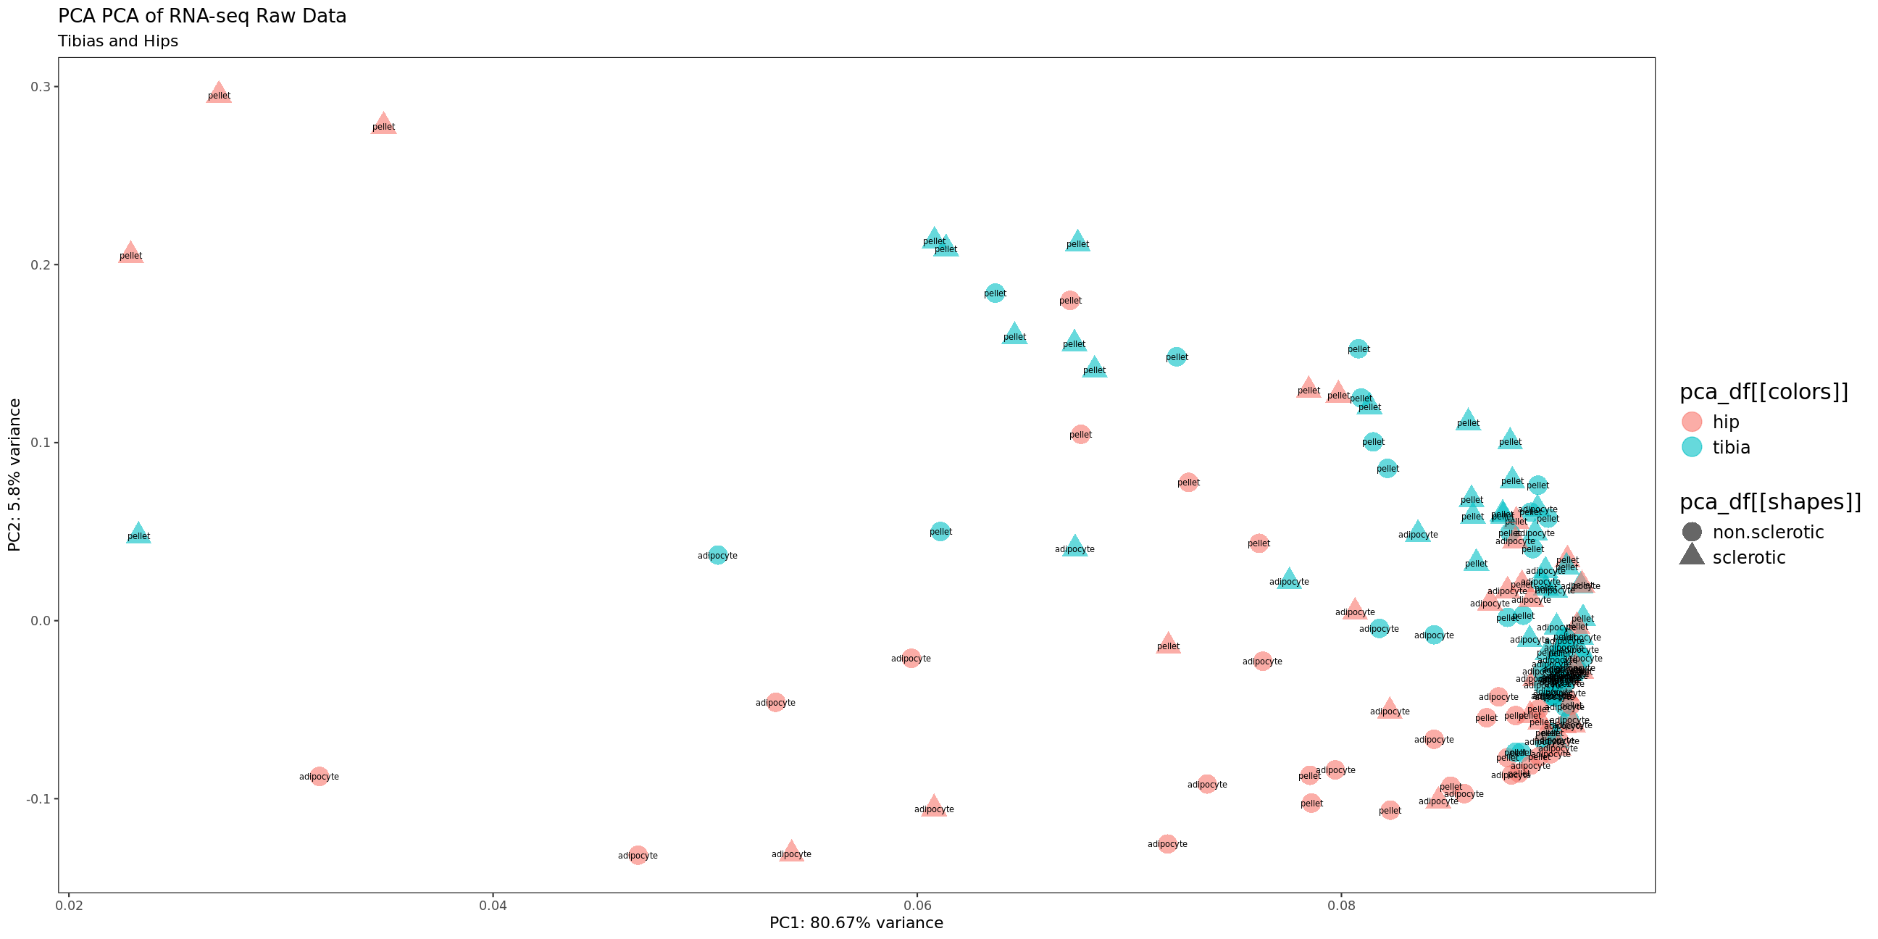

Bone (hip and tibia)

Slide 10
DEG among selected conditions
HIP
Non-Sclerotic vs Sclerotic
Adipocytes non-Sclerotic vs Sclerotic
Pellet non-Sclerotic vs Sclerotic
TIBIA
Non-Sclerotic vs Sclerotic
Adipocytes non-Sclerotic vs Sclerotic
Pellet non-Sclerotic vs Sclerotic
Bone (hip and tibia all)
Hip vs Tibia
Non sclerotic hip vs tibia
Adipocytes hip vs tibia
Pellet hip vs tibia
Sclerotic Pellet tibia vs hip
Non-sclerotic Pellet tibia vs hip
Non-sclerotic Adipocytes tibia vs hip
Sclerotic Adipocytes tibia vs hip
Adipocytes HIP and TIBIA
non-Sclerotic vs Sclerotic
Pellets HIP and TIBIA
non-Sclerotic vs Sclerotic

Slide 11
Matrices
Raw counts
Normalized

Slide 12
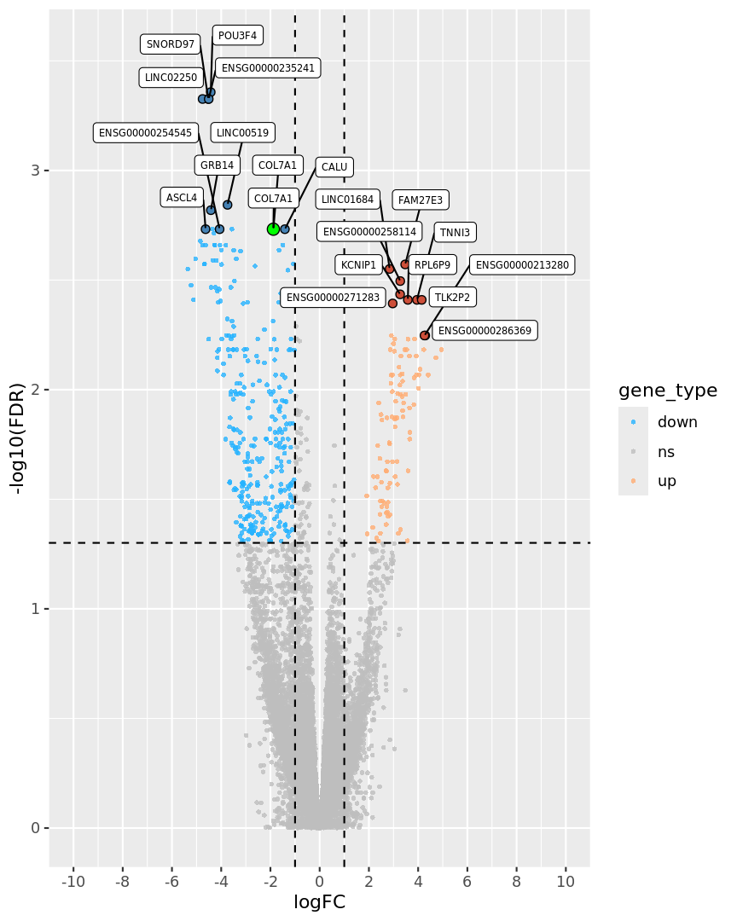
Volcano
Function and graphs

Slide 13
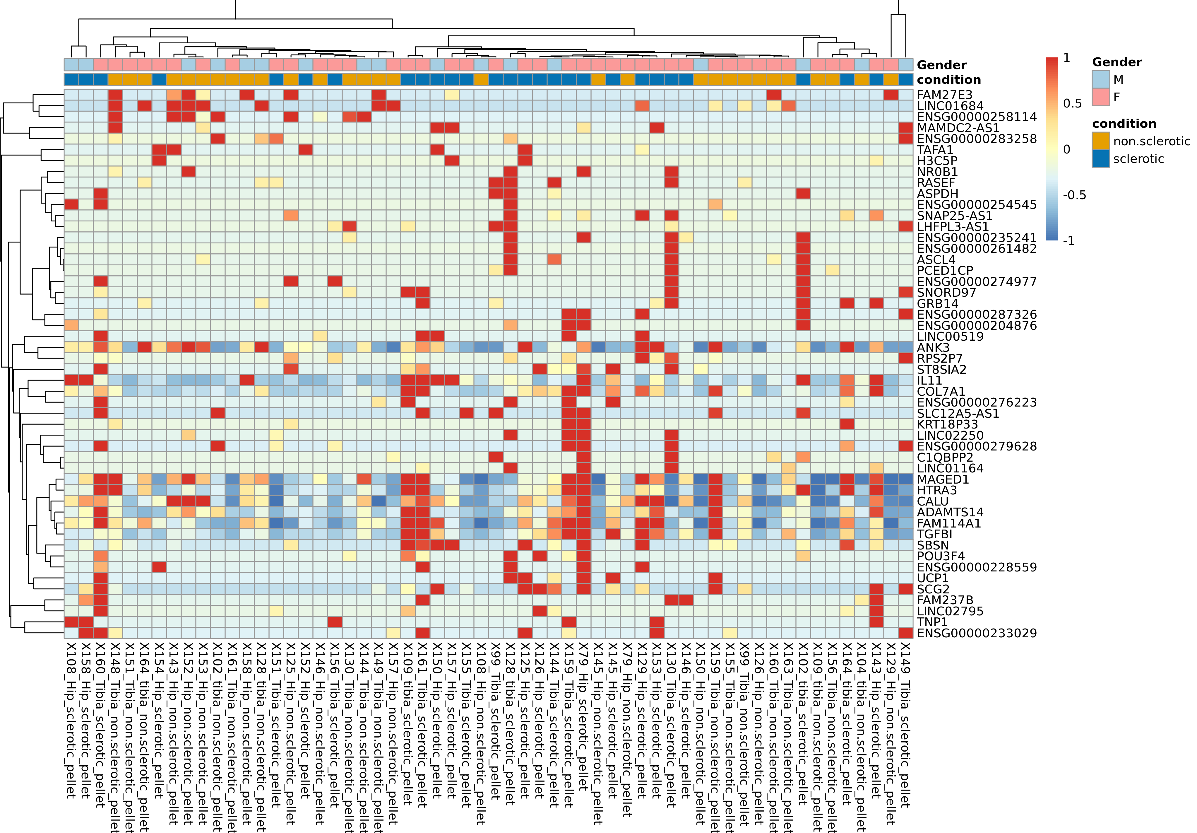
Heatmap
Function and graphs
Raw counts
Comparisson:
pellets_hip_and_tibia_sclerotic_vs_non_sclerotic[[1]]$results$table

Slide 14
Model
Absolutely! Let’s summarize what you want to achieve and then dive into how we can use neural networks for your task.
Objective
You want to build a predictive model using neural networks to classify samples as either sclerotic or non-sclerotic based on gene expression data and metadata. The goal is to train a model that can accurately predict the condition of a sample and understand the features contributing to this prediction.
Data Overview
Gene Expression Data: A matrix where rows represent genes and columns represent samples. Each cell contains the expression level of a gene in a specific sample.
Metadata: Additional information about each sample, such as condition (sclerotic or non-sclerotic), gender, and potentially other factors like age and tissue type.
Steps to Build a Neural Network Model
Data Preparation:
Combine gene expression data and metadata into a single dataframe.
Normalize or scale the gene expression data.
Encode categorical variables (e.g., condition, gender) as numerical values.
Data Splitting:
Split the data into training and testing sets.
Model Building:
Define a neural network architecture suitable for classification.
Compile the model with appropriate loss function and optimizer.
Model Training:
Train the model on the training data.
Model Evaluation:
Evaluate the model’s performance on the testing data using metrics such as accuracy, precision, recall, F1-score, and ROC-AUC.
Model Interpretation:
Analyze the model to understand which features are most predictive of the condition.
Example Code Using Keras in R
Here’s an example of how you might implement this using the keras package in R:
library(keras) library(dplyr) library(caret) # Combine gene expression data and metadata combined_data <- cbind(raw_counts, annotation_col) # Ensure the condition column is a factor combined_data$condition <- as.factor(combined_data$condition) # Encode categorical variables combined_data$condition <- as.numeric(combined_data$condition) - 1 combined_data$Gender <- as.numeric(as.factor(combined_data$Gender)) - 1 # Normalize gene expression data gene_data <- as.matrix(combined_data[, 1:ncol(raw_counts)]) gene_data <- scale(gene_data) # Combine normalized gene data with metadata combined_data <- cbind(gene_data, combined_data[, (ncol(raw_counts) + 1):ncol(combined_data)]) # Split the data into training and testing sets set.seed(123) # For reproducibility trainIndex <- createDataPartition(combined_data$condition, p = .7, list = FALSE, times = 1) train_data <- combined_data[trainIndex, ] test_data <- combined_data[-trainIndex, ] # Separate features and labels x_train <- as.matrix(train_data[, -ncol(train_data)]) y_train <- train_data$condition x_test <- as.matrix(test_data[, -ncol(test_data)]) y_test <- test_data$condition # Define the neural network model model <- keras_model_sequential() %>% layer_dense(units = 128, activation = 'relu', input_shape = ncol(x_train)) %>% layer_dropout(rate = 0.4) %>% layer_dense(units = 64, activation = 'relu') %>% layer_dropout(rate = 0.3) %>% layer_dense(units = 1, activation = 'sigmoid') # Compile the model model %>% compile( loss = 'binary_crossentropy', optimizer = optimizer_adam(), metrics = c('accuracy') ) # Train the model history <- model %>% fit( x_train, y_train, epochs = 50, batch_size = 32, validation_split = 0.2 ) # Evaluate the model model %>% evaluate(x_test, y_test) # Predict on the test data predictions <- model %>% predict_classes(x_test) # Confusion matrix confusionMatrix(as.factor(predictions), as.factor(y_test))
Explanation:
Data Preparation: Combines and normalizes the data, encodes categorical variables.
Data Splitting: Splits the data into training and testing sets.
Model Building: Defines a neural network architecture.
Model Training: Trains the model on the training data.
Model Evaluation: Evaluates the model’s performance on the test data.
This should give you a solid starting point for using neural networks to predict the condition of your samples. If you have any more questions or need further assistance, feel free to ask!

